Slide 1

Click here for audio
01| Culture – What is „culture“? How does it affect us?
02|Welcome to EUF!
03|Important information & services
04| Flensburg – A lively place to work at

Slide 2
01| Culture
Click here for audio
Academic Definitions
“Culture consists of the unwritten rules of the social game. It is the collective programming of the mind that distinguishes the members of one group or category of people from others.”
– Hofstede (1991/94), p.6
“[Culture] denotes an historically transmitted pattern of meanings embodied in symbols, a system of inherited conceptions expressed in symbolic forms, by means of which men communicate, perpetuate, and develop their knowledge about and attitudes toward life.
Geertz (1973), p.89
“Culture reaches out to create a symbolic textuality, to give the alienating everyday an aura of selfhood, a promise of pleasure.”
Bhabha (1994), p.172

Slide 3
01| Culture
Click here for audio
Academic Definitions
Structural | Fluid
Often used in comparative studies and intercultural trainings | Critical approach towards the concept of culture as a tool to justify hierarchy and colonial power dynamics
Commonly focused on national or regional differences | Focused on the constant reappropriation of symbols and the lack of fixity
Culture as a set of observable variables (values, attitudes, symbols etc.) | Culture as a construct established in „third space“ through enunciation /utterance of symbols

Slide 4
01| Culture
Culture…
… is a point of debate rather than a well-defined concept
… influences everyone in their day-to-day life, consciously or subconsciously.
… as a concept can be used to legitimize violence and reproduce power dynamics (see Othering, national extremism, epistemic violence etc.)
... is not a universal descriptor for individual people (see stereotyping)
…can be viewed as a societal, material structure or a fluid, self-establishing process
Adapted from S.Simpson, „German Academic culture“
Important!
People, as well as institutions, will not act according to a strict set of cultural rules. Culture is one factor of many influencing our personal decisions and communication. Comparative cultural analysis can be helpful as a very general guideline – in everyday contexts empathy, flexibility, resilience and the ability to withhold feelings of estrangement as well as communicate them is much more valuable!
(see i.e. Bolten, 2007)

Slide 5
01| Culture
Click here for audio
Culture Shock 101 - How do I deal with initial estrangement?
Culture Shock…
… is a normal and common phenomenon to experience
… can cause psychological and physical distress
… can be experienced at different intensities
… is often portrayed in sequential stages
… happens because of cognitive dissonance between expectations and reality
… usually happens in everyday situations, not big conflicts
S.Simpson, „German Academic culture“

Slide 6
01| Culture
Adapted from „Culture Shock“ brochure, Universität Wuppertal and „German Academic Culture“, S.Simpson
Culture Shock 101 - How do I deal with initial estrangement?
Tips on self-care
Click here for audio
Communication: talk about anxieties and ask for explanations
Community: make new friends, share your experiences, seek support in your social surroundings
Curiosity: be open and proactive in new experiences, try out new food, clothing etc., learn and share personal experiences with other, take time to consciously observe and listen
Care: be patient with yourself and others, try to establish an „island of familiarity“ (a place or a thing that makes you feel at home), stimulate positive thoughts, reflect on experiences in a diary, be mindful of pressure to feel accepted or liked by every person, try to take a humorous stance at small mishaps, keep a routine
→ Struggling with culture shock and looking for support? Feel welcome to reach out to our International Staff Network (ISNet)!

Slide 7
02| Welcome to EUF!
General profile
In 2025:
5648 students enrolled (majority of them female), 338 academic staff, 236 administrative and technical staff, 83 professorships
International semester times (March to June, September to December)
Strongly geared towards educational sciences
Internationally oriented: Europa-Universität
More information: https://www.uni-flensburg.de/en/about-euf/profile-of-euf

Slide 8
02| Welcome to EUF!
Research profile
Strong focus on educational science / teaching as well as European studies
ZeBUSS (Centre for research of education, classroom teaching, school and socialization - https://www.uni-flensburg.de/en/zentrum-fuer-bildungs-unterrichts-schul-und-sozialisationsforschung-zebuss), ICES (Interdisciplinary Centre for European Studies - https://www.uni-flensburg.de/en/ices)
Transformation and sustainability
CREST (Centre for Research on Sustainability and Transformation - https://www.uni-flensburg.de/en/translate-to-2-englisch-crest), DWJZ (Dr. Werner-Jackstädt Centre - https://www.uni-flensburg.de/en/iim/cooperation/jackstaedt-zentrum-flensburg), ZNES (Centre for Sustainable Energy Systems - http://www.znes-flensburg.de/?language=en), NEC (Norbert Elias Centre)
Regional contemporary history and public history
FRZPH (Research Centre for Regional Contemporary History and Public History - https://www.uni-flensburg.de/frzph (only available in German))
Regional and minor languages
KURS (Centre for Regional and Minor Languages - https://www.uni-flensburg.de/en/zentrum-kurs)
French and Irish studies
→ CANOFF (Campus Nord for France and Francophony - https://canoff.de/ (only available in German)), CFIS (Centre for Irish Studies - https://www.uni-flensburg.de/en/irishstudies)

Slide 9
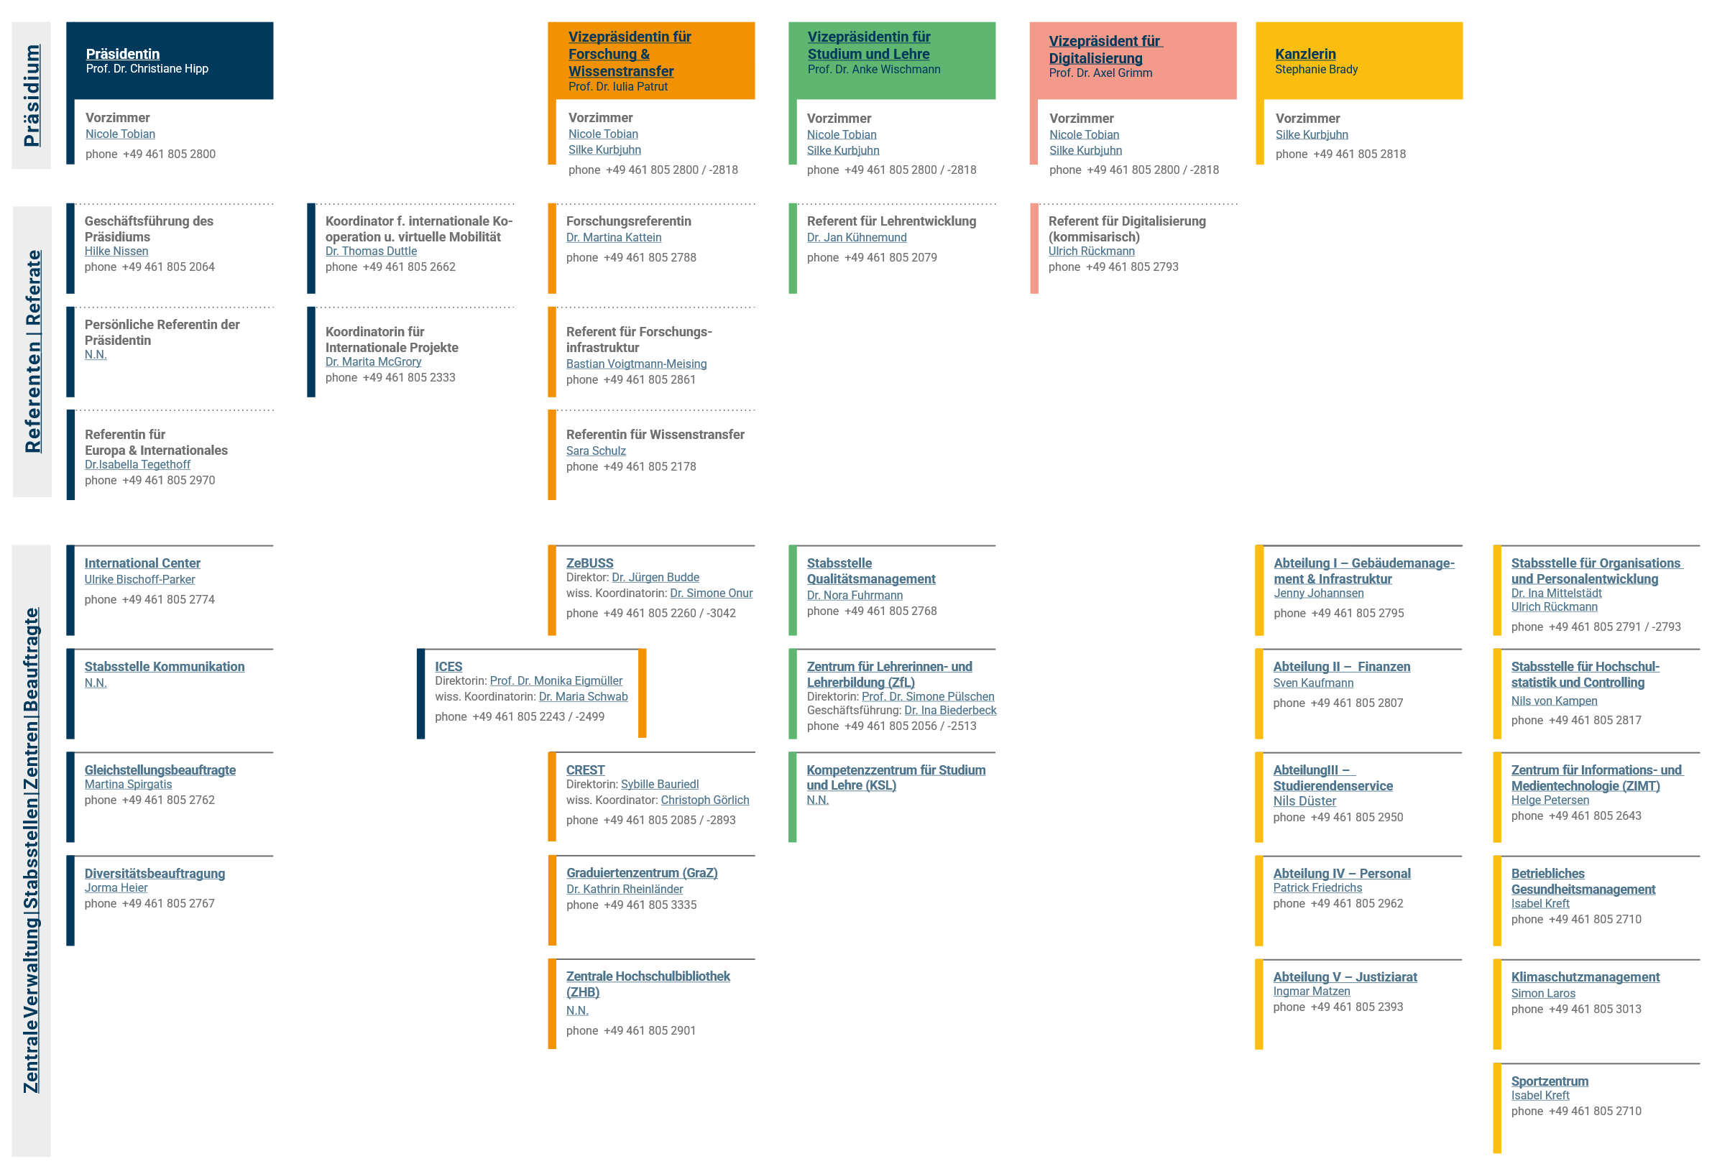
02| Welcome to EUF!
https://www.uni-flensburg.de/en/about-euf/organization-and-structure
Full translation here
University units governed by the Executive University Board
Click here for audio

Slide 10
02| Welcome to EUF!
Executive University Board
Members:
- President
- Department for European and International Affairs
- VP for Research and Knowledge Transfer
- VP for Teaching and Learning
- VP for digitalization
- Chancellor
Highest governing body, meet once a week
Proposals for agenda possible to be submitted by campus community
Located in DUB
More information and forms for proposal: https://www.uni-flensburg.de/en/about-euf/organization-and-structure/executive-university-board#c184080

Slide 11
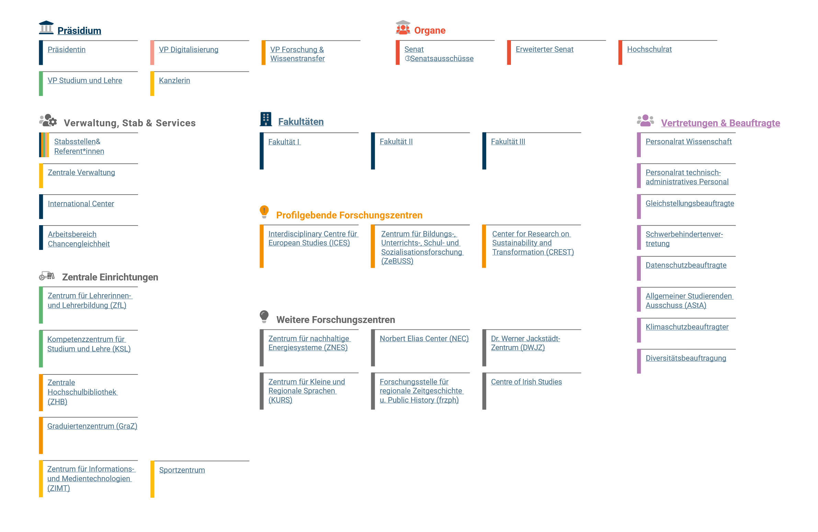
02| Welcome to EUF!
Click here for audio
https://www.uni-flensburg.de/en/about-euf/organization-and-structure
Full translation here
Structural units of EUF

Slide 12
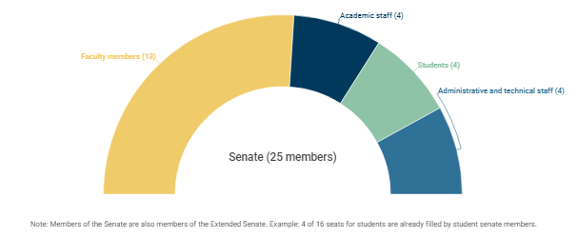
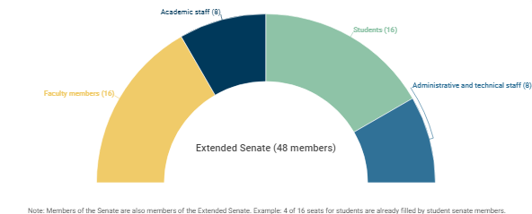
02| Welcome to EUF!
Click here for audio
Senate
Members:
Elected for either two years (staff) or one year (students), quotas legally defined
25 in senate, 23 more in extended senate
Enacts university constitution
Discusses research priorities
Advises on degree programs
Decides on the structural and developmental plan
Meets once a month during lecture period, open to the public – links to online broadcasts are distributed via mail
Elects members of the Exec. board
More information and meeting dates:
https://www.uni-flensburg.de/en/about-euf/organization-and-structure/senate
https://www.uni-flensburg.de/en/about-euf/organization-and-structure/senate/senate-committees/committee-calendar

Slide 13
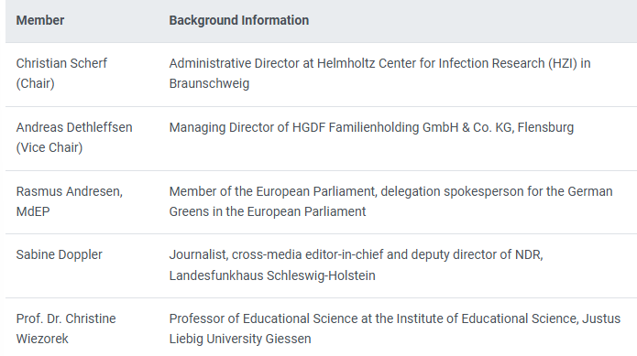
02| Welcome to EUF!
University Council
Members:
Members proposed by the Senate for four years
Supports and guides the university and its development
Gives opinion on strategic decisions
Makes recommendations for research and teaching profile
→ More information: https://www.uni-flensburg.de/en/about-euf/organization-and-structure/university-council

Slide 14
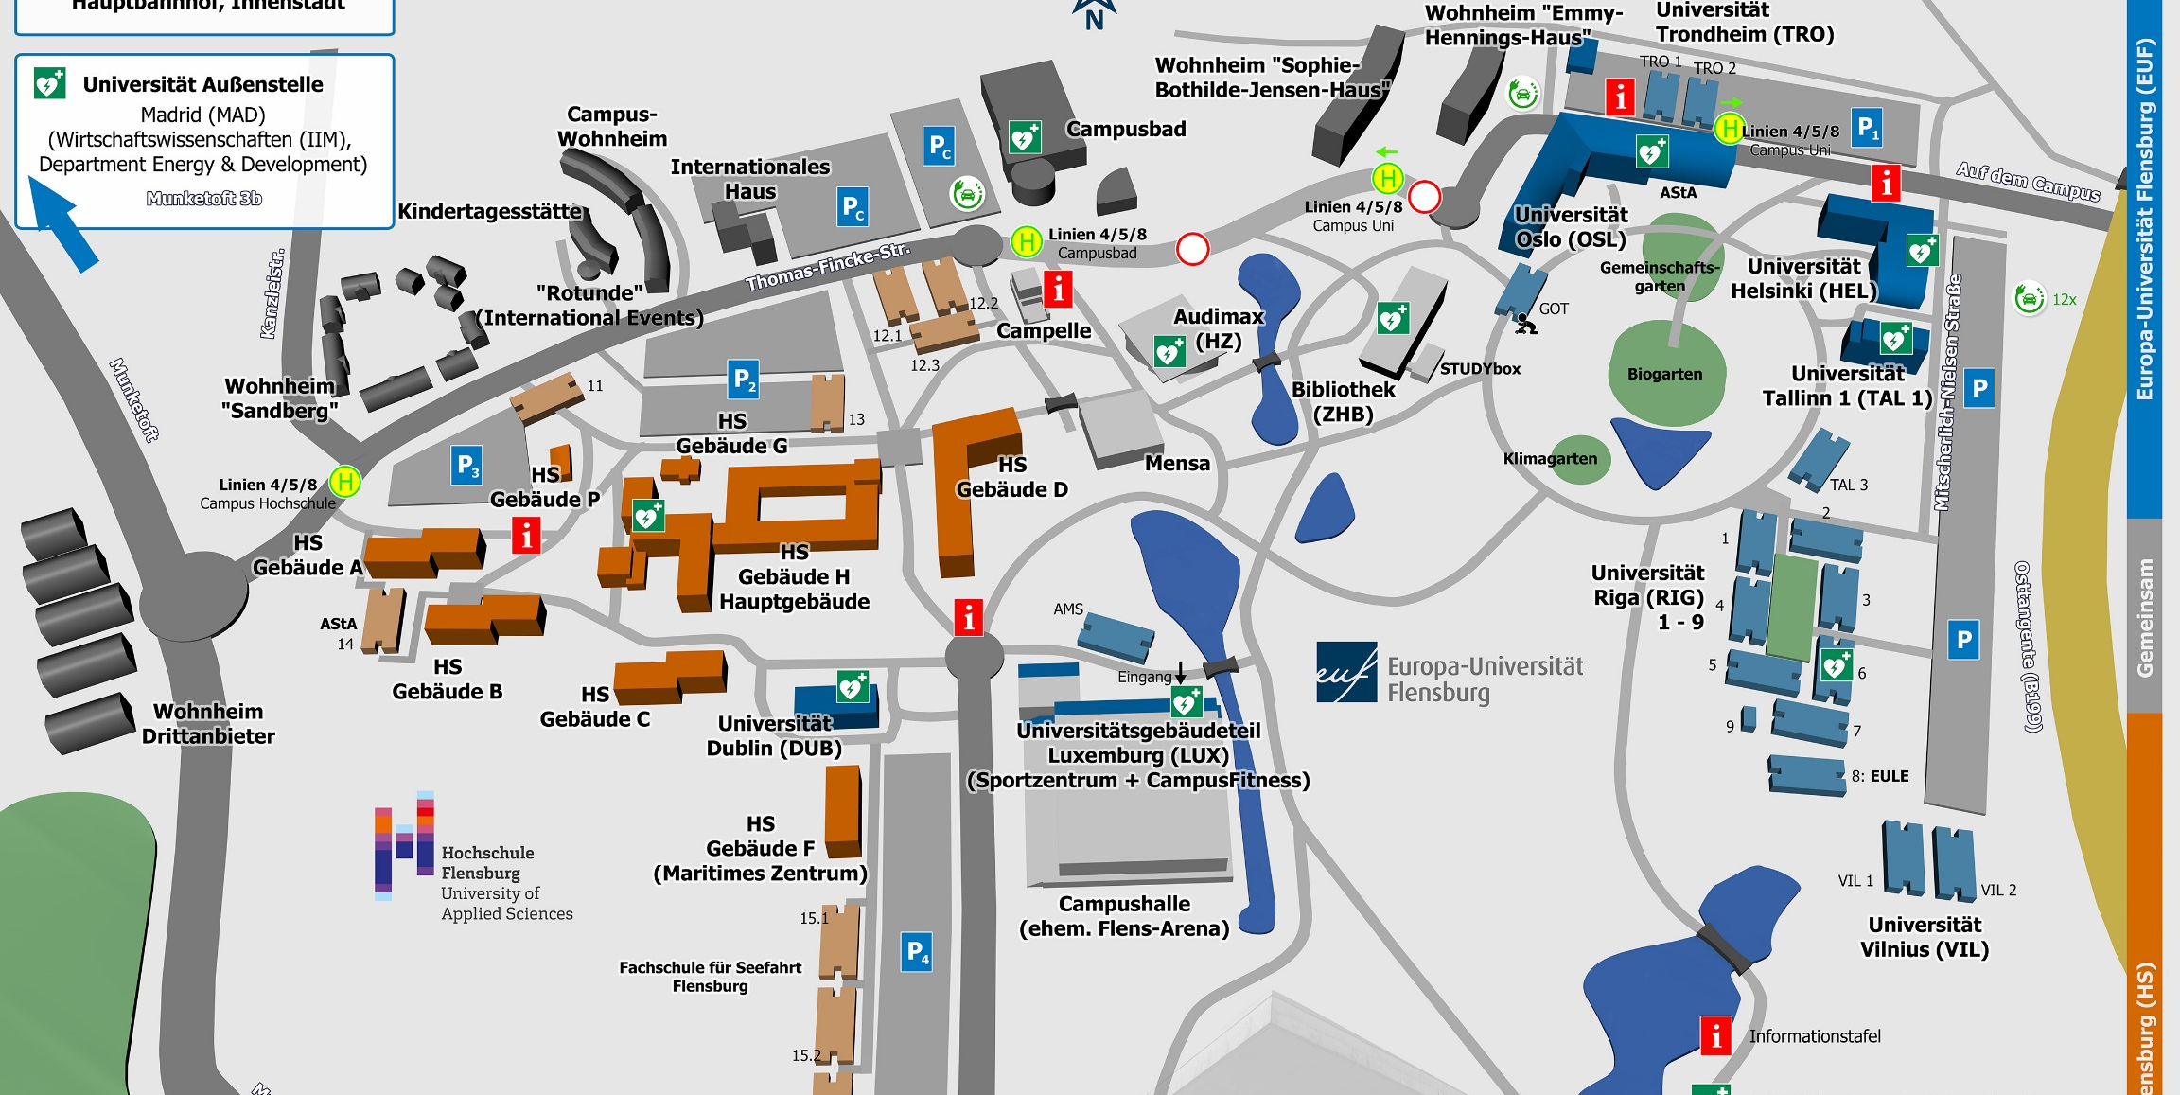
02| Welcome to EUF!
https://www.uni-flensburg.de/en/about-euf/contact-and-opening-hours/campus-map
→ See also: https://www.uni-flensburg.de/en/about-euf/our-campus for 360-panoramic tour (audio only available in German)

Slide 15
02| Welcome to EUF!
Click here for audio
Getting around on campus
Buildings named after European cities:
OSL (Oslo): big main building right in the center of Campus,
HEL (Helsinki): second main building next to OSL,
TRO (Trondheim): containers in front of OSL
TAL (Tallinn): building next to the entry to Campus Suite in HEL
RIG (Riga): containers behind TAL
VIL (Vilnius): containers behind RIG
DUB (Dublin): building across the GP Joule Arena
AMS (Amsterdam): containers close to Hochschule
MAD (Madrid): building off campus near the brewery
GOT (Göteborg): container near the library
LUX (Luxemburg): building next to/under the GP Joule arena
Rooms are numbered by floors or buildings (just in TRO, RIG, VIL)
More information: https://www.uni-flensburg.de/en/about-euf/contact-and-opening-hours/addresses-and-opening-hours#c122079

Slide 16
02| Welcome to EUF!
Click here for audio
Getting around on campus
Important room numbers:
  Zimt service: HEL 301 (zimt-service@uni-flensburg.de)
  Executive board: DUB 206 (office.praesidium@uni-flensburg.de)
  Equal Opportunities Department:
    AGG Grievance Office: DUB 009b (anja.hansen@uni-Flensburg.de)
    Equal Opportunity Consultants: DUB 009a (martina.spirgatis@uni-flensburg.de), OSL 484 (sybille.bauriedl@uni-flensburg.de), HEL 134 (delhom@uni-flensburg.de)
    Diversity Consultant: DUB 009d (jorma.heier@uni-flensburg.de)
    Family Office: DUB 009c (familienservice@uni-flensburg.de)
  International Center: HEL 030-036 (int-center@uni-flensburg.de)
  Telephone Centre / Information: OSL 067 (jenny.johannsen@uni-flensburg.de)
  Central Postal Service: OSL 063.1 (meltro@uni-flensburg.de)
  Central Room Planning: HEL 016a (raum@uni-flensburg.de)
  Daycare room: GOT 006
  Open PC lab: GOT 001
  Quiet room: GOT 008

Slide 17
02| Welcome to EUF!
Getting around on campus
Other important places on Campus:
  Audimax: big lecture hall next to the Mensa
  ZHB: university library, between OSL and Audimax
  Mensa: across the Campusbad, open Mo-Fr 11.15–14.00, daily menu available at https://studentenwerk.sh/en/mensen-in-flensburg?ort=2&mensa=7#mensaplan , small cafeteria at the entrance, payment with Campuscard or an EC-card
  Mind & Mocha (former Campus Suite): in HEL, for coffee, cake and snacks
  Kita: next to Campusbad, daycare for children of university members
  Campelle: room for religious and spiritual practice, in front of Mensa
  Opening hours vary between the regular semester and the lecture-free period.

Slide 18
02| Welcome to EUF
Opportunities for connection
Calendar:
For all events: https://www.uni-flensburg.de/en/university-communications/university-calendar
For international programmes & events: https://www.uni-flensburg.de/en/international
DokNet
(https://www.uni-flensburg.de/en/research/doctoral-and-early-career-researchers/doctoral-students-interdisciplinary-network-doknet#c159590)
Network for doctoral candidates
Meetups online via Webex
Contact at doknet@uni-flensburg.de
ISNet
www.uni-flensburg.de/kompetenzzentrum-studium-lehre/hochschuldidaktik/the-international-staff-network-at-the-euf
Network for staff members interested in internationalization
Meetings for coffee in the Campus Suite
Webex space available
Contacts: https://www.uni-flensburg.de/kompetenzzentrum-studium-lehre/hochschuldidaktik/the-international-staff-network-at-the-euf/contacts
Gender Network
www.uni-flensburg.de/diversity/gender-netzwerk/ueber-das-netzwerk (only available in German)
Interdisciplinary forum on topics regarding gender dynamics
Organizes public lecture series
Contact: juno.grenz@uni-Flensburg.de

Slide 19
02| Welcome to EUF
Opportunities for further education
Research centres & faculties
Research funding advisory service offered by ICES at https://www.uni-flensburg.de/en/ices/services/research-funding
Events at ICES and ZeBUSS, possibility to become a member and/or receive the monthly newsletter
Regular colloquia, events etc., information best acquired via the faculty website, the secretariat or your colleagues as well as the calendar
KSL – Centre for competencies in study and teaching
Regular courses open mostly for teaching staff members, enrolment at https://www.uni-flensburg.de/kompetenzzentrum-studium-lehre/hochschuldidaktik/fortbildungsangebot (available only in German)
Certificate program „Reflactive Teaching“, information at https://www.uni-flensburg.de/kompetenzzentrum-studium-lehre/hochschuldidaktik/zertifikatsprogramm-reflactive-teaching (available only in German)
Contact: kathrin.rheinlaender@uni-flensburg.de
Language courses
University staff can enrol for language courses offered by our language centre for free at https://www.uni-flensburg.de/en/international/languages/language-center/language-courses
Semester courses and intensive courses during the lecture-free period as well as self-study options available
Language tandem offered for an informal approach

Slide 20
03|Important information & services
Technical Crash Course
Mail
Generally firstname.lastname@uni-flensburg.de
Login with the User ID and password provided by ZIMT: https://www.uni-flensburg.de/en/webmail or via outlook client
Sharing documents
Apply for EUFbox account: eufbox-admin@uni-flensburg.de
Login with ZIMT user login at eufbox.uni-flensburg.de
Upload files, create a share link (file size limit is 2 GB)
Wifi
Eduroam: download Installer at www.uni-flensburg.de/eduroam
IMPORTANT: username has to end in „@uni-flensburg.de“
In case of eduroam not working and for setup:
  Campus-Visitor (password here: https://www.uni-flensburg.de/?id=26843)
  Uni-Studenten (password here: https://www.uni-flensburg.de/zimt/services/services-fuer-studierende/wlan/altes-wlan-ersatz-wlan)
Website navigation
→ five-digit page numbers: enter in the search bar instead of a link (make sure your page is set to German when using this method)
→ Useful websites: 10049 (All Services A-Z), 12871 (ZIMT), 26669 (transponder & keys), 12315 (mail setup), 24782 (room reservation), 52929 (time recording), 40177 (staff representatives)
https://www.uni-flensburg.de/en/zimt/services/services-for-employees

Slide 21
03|Important information & services
Technical Crash Course
Software
→ Anti-virus software Sophos Home Premium, free for up to 10 devices, info at https://www.uni-flensburg.de/startseite-des-intranets/gremien-organisation/zentren/zentrum-fuer-informations-und-medientechnologien-zimt/antivirenprogramm-sophos (available only in German)
For work use: several programs installable via the EUF Software Kiosk for free (i.e. Adobe Acrobat, Mindjet, SPSS, MAXQDA, Adobe Media Software, Teamdrive), guide at www.uni-flensburg.de/index.php?eID=dumpFile&t=f&f=4123405&token=665da347ddca7263bc8933d6a698c34e50e1fbd4 (available only in German)
For private use: Microsoft Office 365 at https://www.uni-flensburg.de/en/zimt/services/services-for-employees/office-365
Time tracking software (only relevant to administrative staff)
Via Time 3010, guide at https://www.uni-flensburg.de/index.php?eID=dumpFile&t=f&f=4144628&token=f0649cdaf04f8ca5d098b656116ccf31c1782d85 (available only in German)
VPN for working from home
→ Via Cisco AnyConnect Secure Mobility Client
→ Installation at https://vpn-extern.uni-flensburg.de/Dozent (login with your user data, then download and install the software before clicking ‚Connect‘ and logging in a second time)
→ Access to data that is usually only accessible on campus

Slide 22
03|Important information & services
Important terms for teaching at university
What is a „Modulkatalog“?
A document specific to the degree programme containing descriptions, desired learning outcomes, contents covered, teaching formats, the expected workload, examination types, language of instruction as well as the frequency of the courses (or modules) offered within the programme
Can be used as a guideline and handbook to design your lectures and choose appropriate methods
Access via the university website (example B.A. European Cultures and Society: https://www.uni-flensburg.de/fileadmin/content/portal/die-universitaet/dokumente/po-studiengaenge/bachelor-of-arts/european-cultures-and-society/2025/modulkataloge-hese/mh-baeucs-po2025.pdf)
What is the „Prüfungsordnung“?
A legally binding framework specific to each study programme statuating the conditions for graduation, examinations, accreditation and admission
Sets the rulebook for a degree programme that has to be followed by teaching staff
Access via the university website (example M.A KSM (only available in German) https://www.uni-flensburg.de/fileadmin/content/portal/die-universitaet/dokumente/satzungen/amtliche-satzungen/2023/20230614-satzung-psto-ma-ksm-2023.pdf)
What is the „Rahmenprüfungsordnung“?
Legally binding framework for the whole university regarding rights of the student body, general examination rules, grading system, ECTS regulations, types of examinations and final degree requirements
Generally you will consult the specific Prüfungsordnung of your study programme, but if something is not clarified it might help to check the Rahmenprüfungsordnung or ask in the examination office
Available at https://www.uni-flensburg.de/fileadmin/content/studiengaenge/eucs/dokumente/downloads/2024/en-20240125-rapo-2020.pdf

Slide 23
03|Important information & services
Infrastructure
Postal service
Personal Campus mailbox for internal mail as part of work equipment, please pick up your key from the university postal service after scheduling an appointment: poststelle@uni-flensburg.de
Mail arrives at 10:30 am in OSL and HEL and in the early afternoon for other buildings
Transponder
Issued by institute, available for pickup from Building Management and Infrastructure after scheduling an appointment: schliessanlage@uni-flensburg.de
Telephone
If unsure about a number, call +49 461 805 02 for the campus operator
Also call this number in case you lost an item for the Lost & Found service
Pdf list of numbers available at https://www.uni-flensburg.de/startseite-des-intranets/formulare-dokumente/gebaeudemanagement-und-infrastruktur/telefonverzeichnis (available in German only)
Booking rooms
For bookings, contact room planning at raum@uni-flensburg.de
Overview over room capacities and properties:
https://www.uni-flensburg.de/fileadmin/content/spezial-einrichtungen/raumplanung/dokumente/raeume-ausstattung-f.-webseite-03.12.2024.pdf (available only in German)
https://www.uni-flensburg.de/en/zimt/services/services-for-employees/lecture-room-technology

Slide 24
03|Important information & services
Infrastructure
Newsletters
→ You can choose the newsletters you want to receive via mail at https://www.uni-flensburg.de/startseite-des-intranets/settings/meine-infokanaele-managen-fuer-beschaeftigte (available only in German)
Mensa
Ask for a Campuscard at the cafeteria in the front part of the Mensa building – it will cost 20 euros, 8 of which are credit to use for payment already, you can charge the credit with a debit card or with cash
Alternative payment by debit card (you might need a German bank account)
Jobticket
Ticket for public transit can be purchased at https://www.nah.sh/de/fahrkarten/jobticket/jobticket-bestellen/#/produktauswahl
Enter the company code JT2100LSH, your personal number and a picture to commission a ticket

Slide 25
03|Important information & services
In case you encounter a problem…
STIMULUS
Free, anonymous counseling service for staff members as well as their family members
Counseling in German and English always available, other languages possible
Always available for health-related or psychological issues
For everyday questions: Mo-Fr, 8-18
For questions regarding leadership tasks: Mo-Fr, 8-17
0800 321 2345, appointments for in-person meetings or videocall possible
In case of emergency
Numbers from campus: 0-110 (police), 0-112 (medical emergency services, fire brigade)
General emergency numbers: 110, 112; 0461-902000 for security services in less urgent situations
Doctor responsible for EUF: Dr. Clemens Zahn, Mürwiker Str.89 – in case of a work-related accident consult this doctor and report to Mrs. Gradert afterwards at vanessa.gradert@uni-flensburg.de for compensation
In case of discriminating experiences
For a formal complaint please contact agg.beschwerdestelle@uni-flensburg.de
Advice on the right contact person at anja.hansen@uni-flensburg.de
Diversity consultant: jorma.heier@uni-flensburg.de
Equal opportunity consultant: martina.spirgatis@uni-flensburg.de
Disability consultant: patrick.friedrichs@uni-flensburg.de
Staff council W (research staff), Staff council TAP (administrative staff) personalrat-w@uni-flensburg.de
External counseling offer provided by the city: https://www.flensburg.de/PDF/BeAGGtiv_Zetteln_verschiedener_Sprachen.PDF?ObjSvrID=2306&ObjID=16461&ObjLa=1&Ext=PDF&WTR=1&_ts=1714045030

Slide 26
03|Important information & services
In case you encounter a problem…
Balancing family and work life
EUF family services, contact at familienservice@uni-flensburg.de
Parent café: meet-up once a month during the semester, dates available in the calendar
Parent-child-room in GOT 006 (transponder available in the family service office) and OSL 148
Kindergarten on campus available, early application to be advised at https://www.kitaportal-sh.de/en/
Technical Failure
→ For general inquiries: ZIMT service desk (HEL 301) or mail to zimt-service@uni-flensburg.de
→ If the beamer is broken: mobile beamers at the ZIMT service desk (HEL 301), the front room of the presidium (DUB 206), MAD 121 and MAD 112
If you‘re missing a cable: ZIMT service Desk (HEL 301)
With your bike
→ Open guided repair and maintenance sessions at BikeLab every Wednesday between 13:30 and 16:30 in front of GOT 010

Slide 27

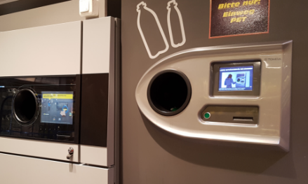
04| Flensburg – A lively place to work at
Tips for everyday life and fun
Opening hours: Generally speaking, shops in the centre close around 7 pm, grocery stores are open until around 8-10 pm – On Sundays and legal holidays everything is closed with a few exceptions (kiosk, gas stations, restaurants & cafes, cinema, theatre etc.)
toogoodtogo: foodsharing app many bakeries in Flensburg participate in, works with Paypal
Wochenmarkt: Every Wednesday and Saturday (7:30-14:00), there‘s a farmer‘s market at the Südermarkt with local fresh groceries – at some stands you can only pay with cash, but there is an ATM right next to it
Pfand: plastic and glass bottles with this symbol can be returned at machines in almost every grocery store and exchanged for the „Pfand“-fee paid when buying drinks (usually 0,25 euros per plastic bottle or 0,08 per glass bottle) – some will also take back crates with or without empty bottles in them

Slide 28
04| Flensburg – A lively place to work at
Tips for everyday life and fun
Deutschlandticket: train ticket for 49 euros a month for all of Germany (Important! Only works for Regio trains, busses, U and S-Bahn not the IC or ICE)
Public transportation: Most busses stop at ZOB, the central bus station right in the city centre. Bus stops at university are Campusbad (in front of the cafeteria/Audimax) and Campus Uni (in front of HEL) – bus number 5A, 4 and 8A are driving towards EUF from the city centre. On busradar-flensburg.de you can check the location of your bus in real time in case of uncertainty if it already departed. You can purchase a ticket from the driver directly (cash only) or in the FAIRTIQ app
Trains depart from the central station (Hauptbahnhof), you can check connections via bahn.de, the DB navigator app or nah.sh

Slide 29
04| Flensburg – A lively place to work at
Tips for everyday life and fun
Libraries:
Stadtbibliothek Flensburg (mostly recreational literature, CD, DVD, games, comics etc. – almost exclusively German, small shelf for English literature)
The Danish Central library (Danish literature, archive of the Danish minority including works in Low German, Low Danish, Frisian as well as in the Petuh vernacular special to Flensburg)
The ECMI library (specialized in minority issues, Ombudsman reports, material in >20 languages)
The library of the navy school (Marineschule) (German literature, main focus on nautics, navigation and the navy)

Slide 30
04| Flensburg – A lively place to work at
Tips for everyday life and fun
Museumsberg: changing exhibitions (10 euros a ticket for all of them including Schifffahrtsmuseum at the harbour or 25 euros a year if you become a member of the art association), Christiansenpark nearby
Theatre: Stadttheater Flensburg (plays in German or Plattdeutsch, symphonic orchestra, opera/musicals, ballet), Pilkentafel (smaller stage with a shared topic for all performances each season), Orpheus theatre (room for 60 people only, mix of theatre and musical performances)
Flea markets: There‘s regular flea markets on Sundays during warmer seasons – the biggest ones are at Citti-Park (outside) as well as Fördepark (inside the underground car park), remember to bring cash here as well as only few stands accept Paypal
Cinema: UCI-Kinowelt (standard cinema, check for OmU (Original mit Untertiteln) for English audio with German subtitles or OV (Originalversion) for English audio only), 51 Stufen-Kino (alternative cinema, one hall with an older atmosphere, cheaper prices but smaller program, hosts the „Kurzfilmtage“, a short film festival every year)
Events: bigger events usually take place either in Deutsches Haus or GP Joule Arena (tickets can be bought at the location or eventim.de), in warmer seasons a lot of action takes place at the Hafenspitze – the biggest harbour festivals are called Rum-Regatta and Nautics

Slide 31
04| Flensburg – A lively place to work at
Tips for everyday life and fun
Sports: university sports card (60 euros per semester for courses only or 140 euros with the gym, tickets for a shorter time period can be purchased as well),
handball games in the GP Joule-Arena near the Campus,
regional league football games in Weiche at the Manfred-Werner-Stadion and American Football games (Sealords)
The biggest general sports club is called TSB for many disciplines,
lots of opportunities for sailing due to proximity to water,
a bouldering hall near Citti-Park…
Campusbad: public swimming pool near the university with a sports pool as well as recreational areas and a sauna (open Tuesday to Friday, male or female only sauna every Wednesday), if you plan on going regularly, you might consider buying a Campusbad-Karte for a discount

Slide 32
04| Flensburg – A lively place to work at
More information on Flensburg and the region:
https://www.uni-flensburg.de/en/arbeitsbereich-chancengleichheit-equal-opportunities/welcome-service/flensburg-and-its-surroundings
More information on working in Germany and important documents:
https://www.uni-flensburg.de/en/international/coming-to-flensburg/international-staff#c174668

Slide 33
Bhabha, H.K. (1994). The Location of Culture (2nd ed.). Routledge.
Bolten, J. (2007). Interkulturelle (Wirtschafts-)Kommunikation: ‚Fach‘ oder ‚Gegenstandsbereich‘? In A. Moosmüller (Hg.), Interkulturelle Kommunikation – Konturen einer Disziplin (S. 171–208). Waxmann.
Bourdieu, P. (1986). Forms of Capital, in Richardson, J., Handbook of Theory and Research for the Sociology of Education, pp. 241-58
Geertz, C. (1973). The interpretation of cultures. Basic Books
Hall, E. T. (1976). Beyond culture. Doubleday/Anchor Books.
Hofstede, G. (1991/1994). Cultures and Organizations: Software of the Mind. London: HarperCollinsBusiness.
Nistor, N. & Gogus, A., Lerche, T. (2013). Educational technology acceptance across national and professional cultures: A European study. Educational Technology Research and Development.
Pudelko, M. (2006). A comparison of HRM systems in the USA, Japan and Germany in their socio-economic context., Human Resource Management Journal, 16 (2), p.123-153.
https://www.research-in-germany.org/: Information website by the Federal Ministry of Education and Research (BMBF)
https://www.uni-flensburg.de/ : Official university website
„German Academic Culture“ – Material kindly provided by Scott Simpson from the Orientation course for incoming international students

