Slide 1

Instructions for filling out the Learning Agreement
Notes:
Instructions for filling out the
Learning Agreement

Slide 2
The Learning Agreement
is an official ERASMUS document that guarantees the recognition of courses abroad. Before your departure it has to be submitted to the EUF International Office by scan in one file either in word or pdf (outgoing@uni-flensburg.de). In order to receive financial support it has to be completely and correctly filled in.

Slide 3
Step by Step
There are different sections in the document: "Before the Mobility", "During the Mobility", "After the Mobility". Initially, only the "Before the Mobility" section is relevant to you.
Notes:
Pay attention to the headings in the document: 'Before the Mobility', 'During the Mobility', 'After the Mobility'. For you, only the first section "Before the Mobility" is relevant.

Slide 4
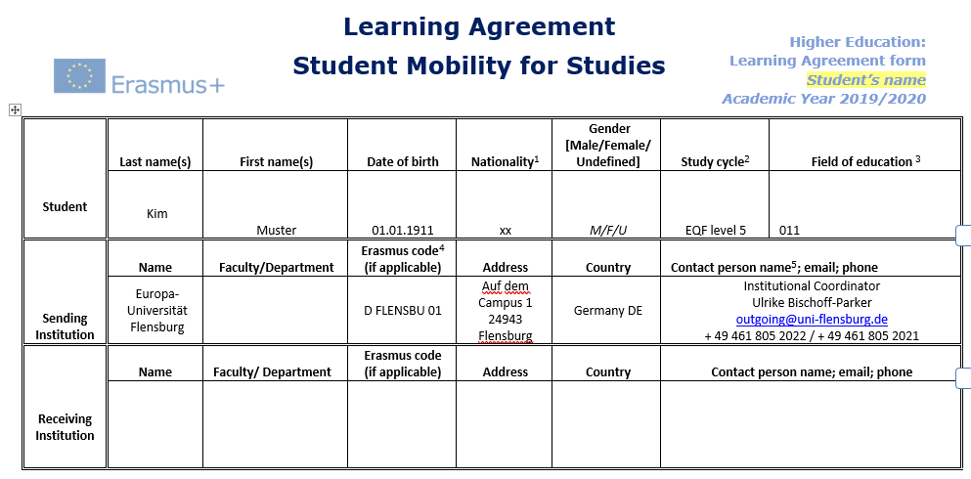
First Table
please fill in

Slide 5
First Table
If you have selected the correct Learning Agreement for your degree programme, the code is already entered here.
optional

Slide 6
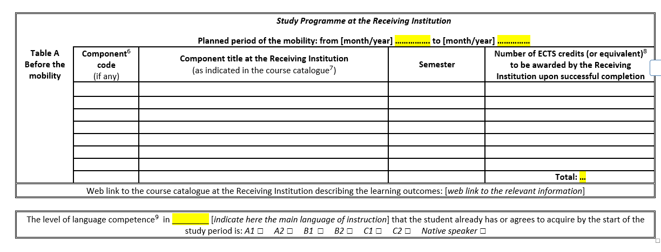
Before the Mobility
please fill in

Slide 7
Before the Mobility
You can find this period in the Acceptance Letter or you can check the Academic Calender on the website of the partner university. Usually, the semester begins with the orientation week and ends with the examination week.
please fill in the course codes of the classes you plan to take

Slide 8
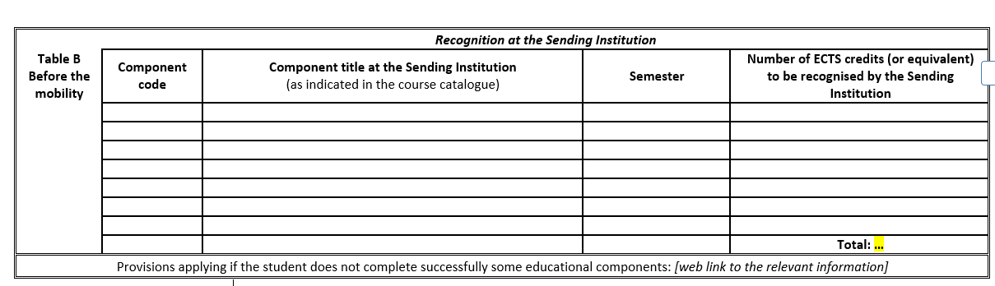
Before the Mobility
please fill in

Slide 9
Before the Mobility
autumn/
spring
please fill in the individual course number

Slide 10
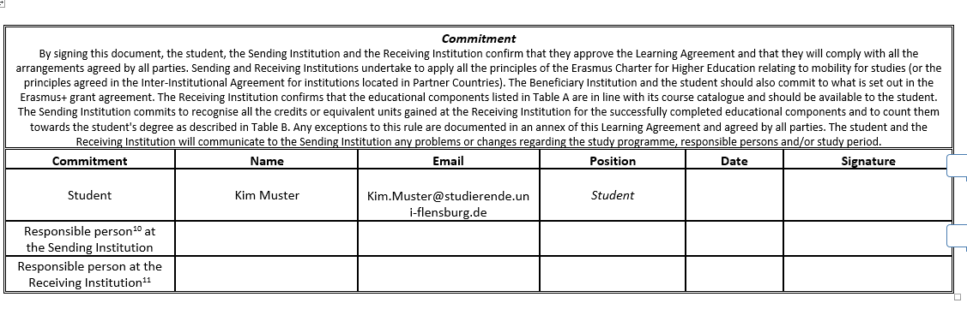
Before the Mobility
please fill in

Slide 11
Before the Mobility
It is important that the Learning Agreement is signed by all parties before the start of your semester abroad.
Digital signatures are allowed on this document.
If you have selected the right Learning Agreement, you will find the person responsible for your degree programme here. Your Learning Agreement will only be valid if signed by this person (not e.g. by individual professors).

Slide 12
Before the Mobility
Our Website for accreditation:
www.uni-flensburg.de/en/international/going-abroad/accreditation-of-courses-taken-abroad/

Slide 13
During the Mobility
If changes are made, please always submit the complete document by scan in one file, not just the part "during the mobility". This is the only way to make your changes comprehensible and valid for later recognition.

Slide 14
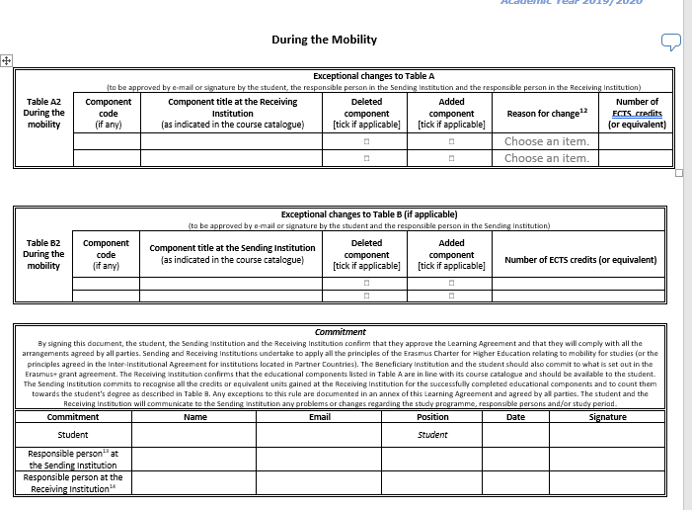
During the Mobility
Sometimes you have to change courses after your arrival at the partner university. You have five weeks to adapt the Learning Agreement. Use the "During the Mobility" section to do this. Only if this section is correctly and completely filled out and signed by everyone the accreditation is assured.
Please contact the person responsible for recognition for your degree programme.
Once all the signatures have been received, please send the scan to the EUF International Office.
Our Website for accreditation:
www.uni-flensburg.de/en/international/going-abroad/accreditation-of-courses-taken-abroad/

Slide 15
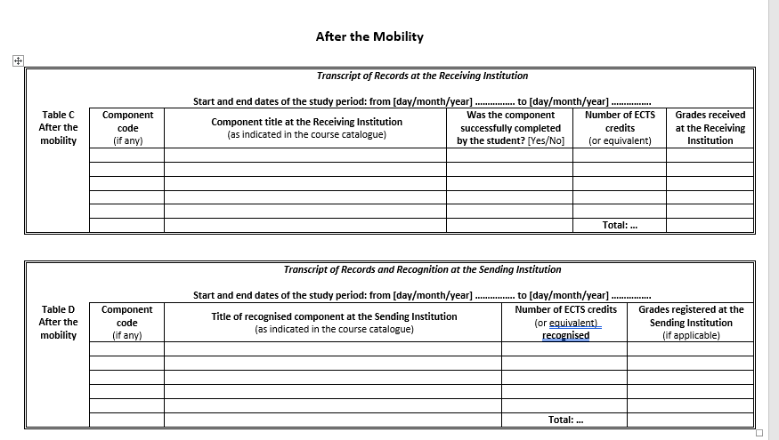
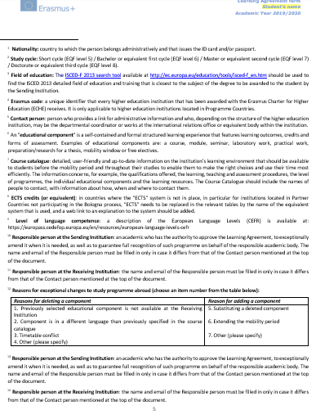
After the Mobility
This section can also be replaced by the Transcript of Records.

Slide 16
Everything filled in?
Well done!

