Slide 1
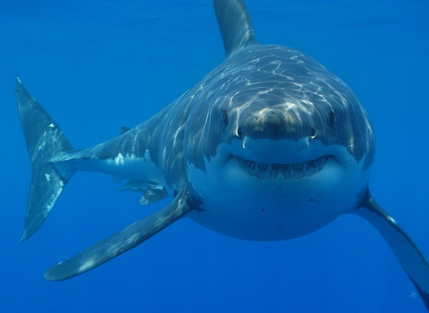
White Shark

Slide 2
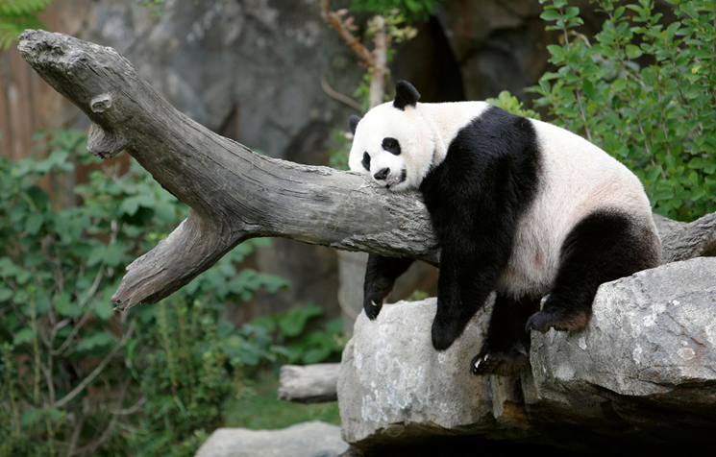
Giant Panda

Slide 3
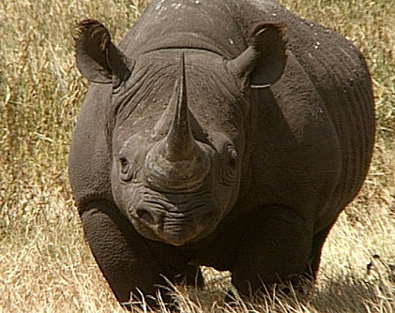
Black Rhino

Slide 4
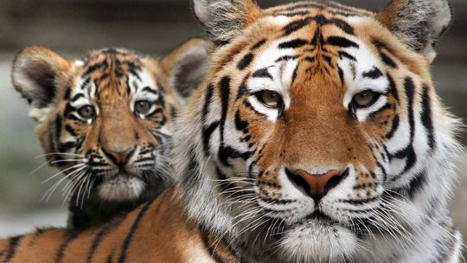
Siberian Tiger

Slide 5
Do you know what these animals have in common?

Slide 6
Endangered species!

Slide 7
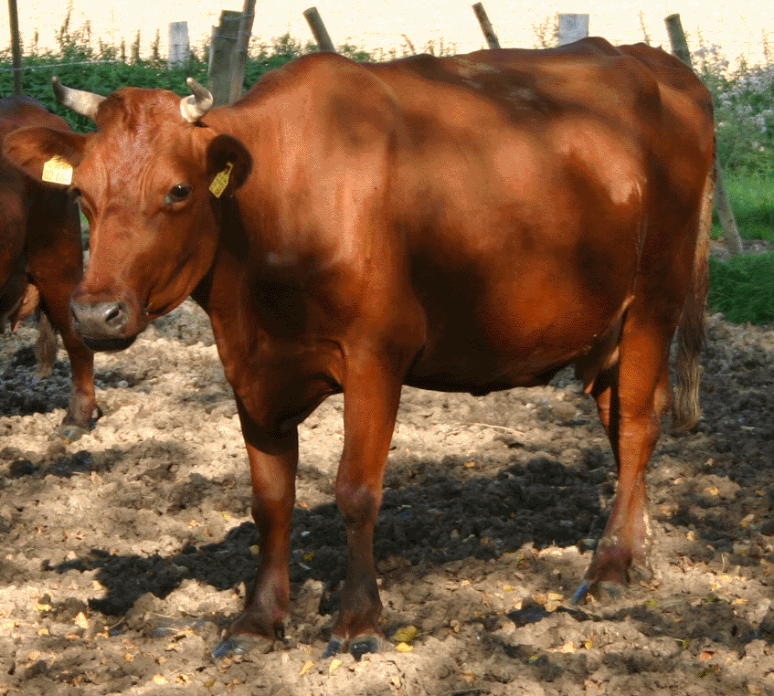
Angler Cow

Slide 8
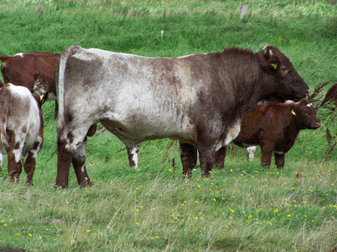
German Shorthorn

Slide 9
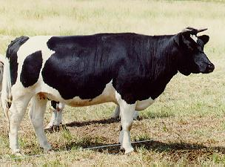
German black pied cattle

Slide 10
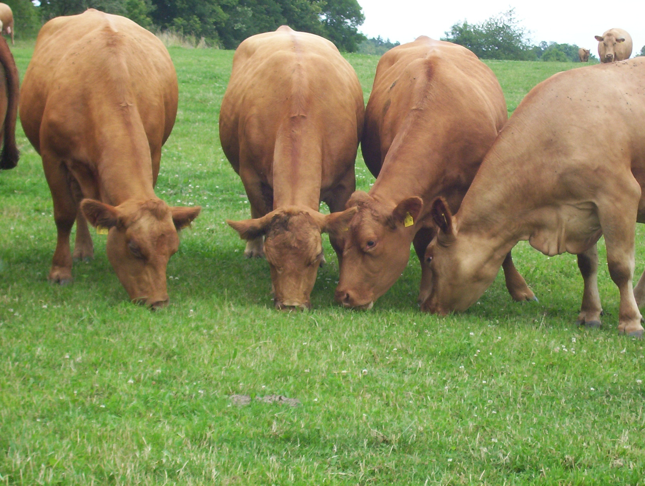
German Yellow

Slide 11
Do you know what these animals have in common with the others?

Slide 12
Different old breeds of cattle

Slide 13
What is different in the conservation of species and breeds?

