Slide 1
Little puzzle

Slide 2
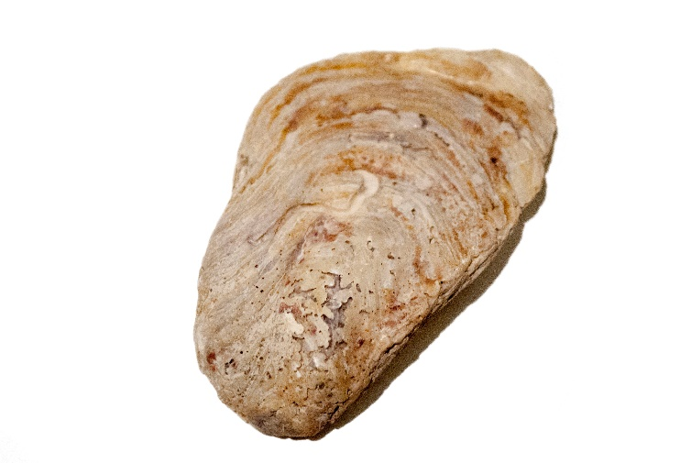
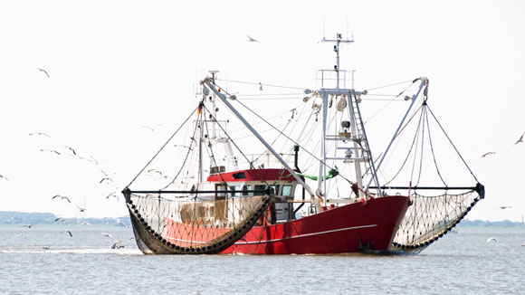
What animal are we looking for?
+ =
Oyster
Catcher

Slide 3
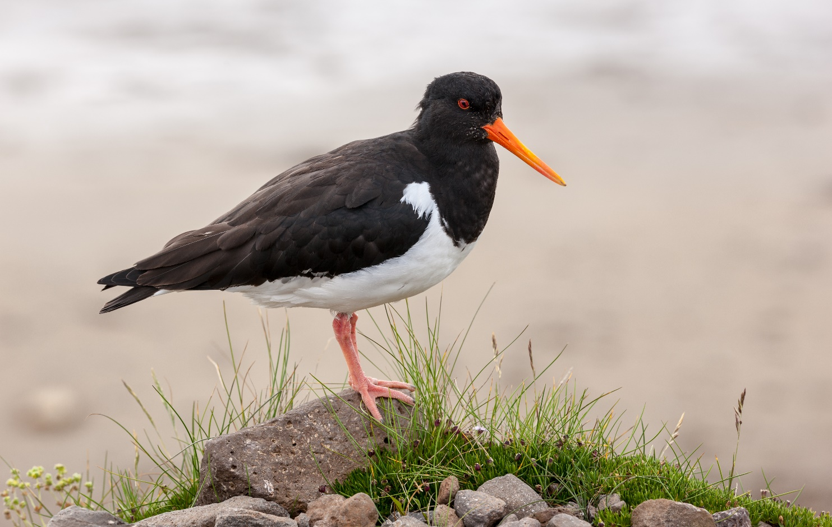
The oystercatcher☺

