Slide 1
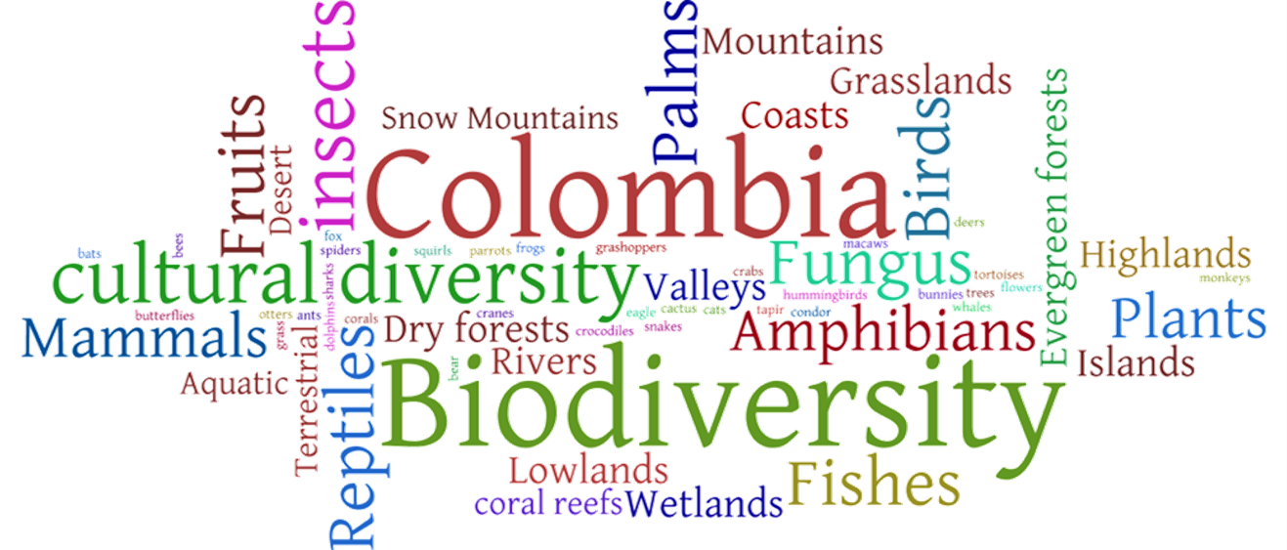
Colombian Biodiversity
Juan Ricardo Gómez

Slide 2
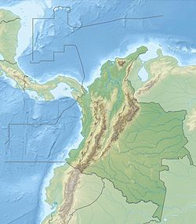
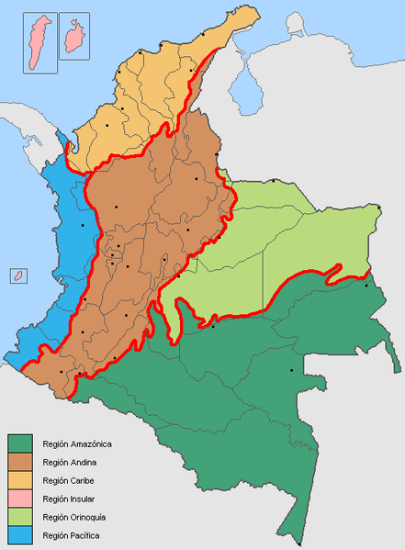
Less than 0.8% of the land of the planet
Equatorial
Around 10% of the living species of the planet
Rainy
Complex geomorphology
Biogeographic history

Slide 3

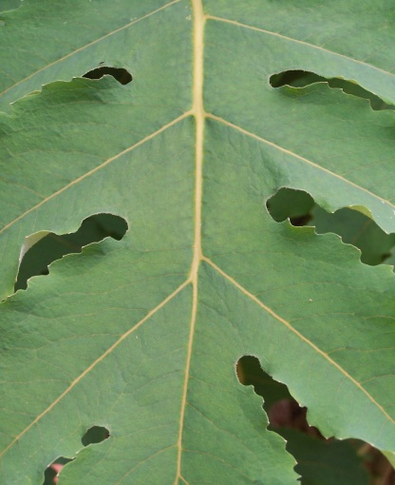
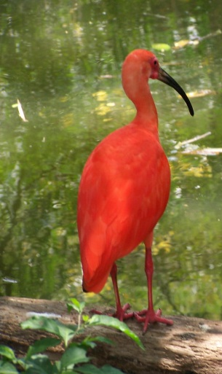
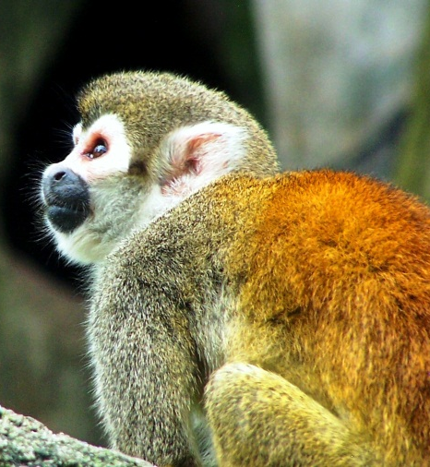
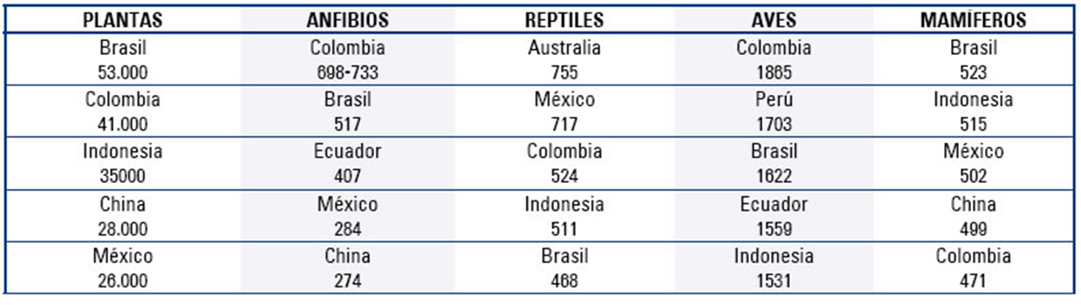
www.humboldt.org.co/download/INSEB_2006-2007.pdf

Slide 4

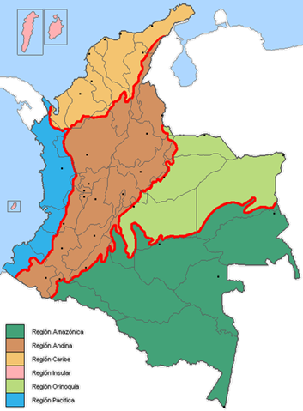
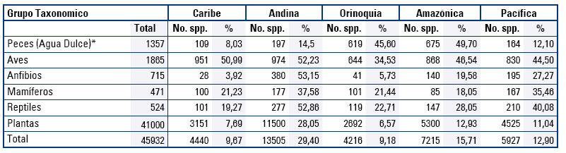
Within Colombia
Fresh water fish
Birds
Anphibians
Mammals
Reptiles
Plants
Total

Slide 5
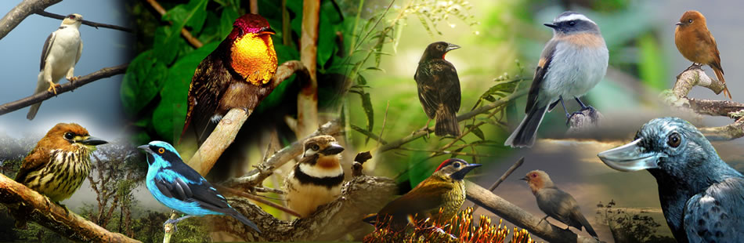
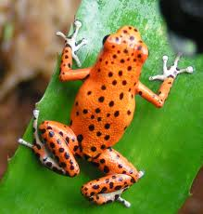
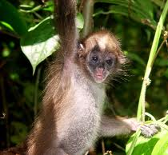
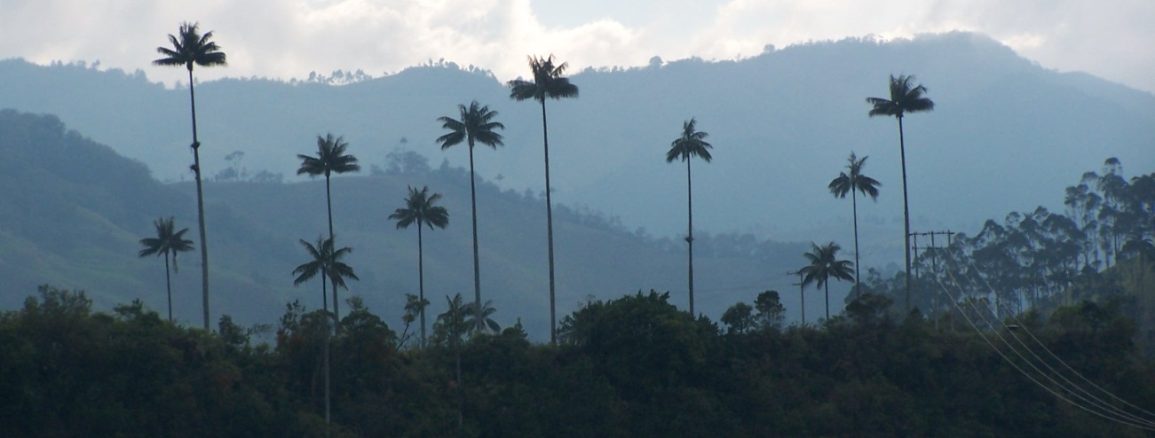
ONLY IN COLOMBIA
66 of
the
birds
manakinnaturetours.com
Arround 400 anphibia
32 of the mammals
ENDEMIC SPECIES
And almost 30% of the flora

Slide 6
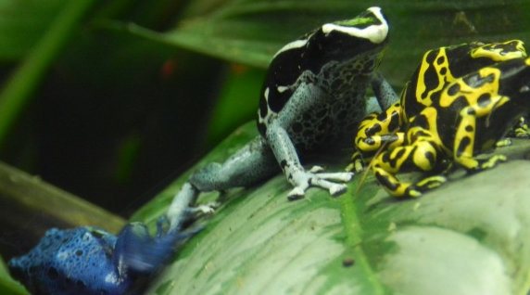
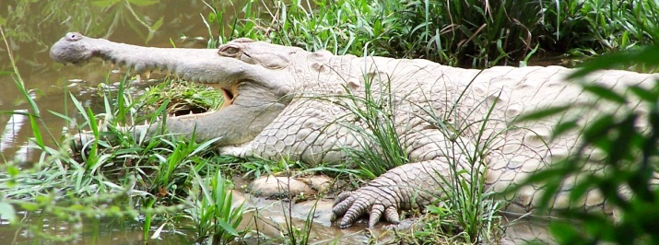
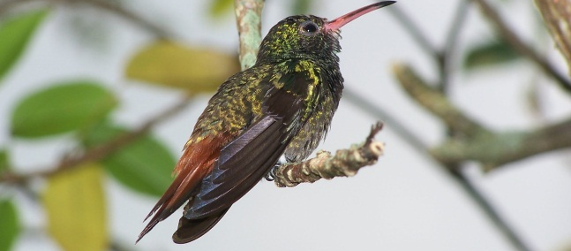
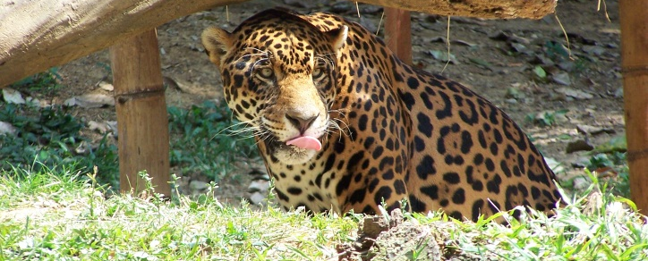
Endangered species
319 vertebrate species are in some treath (49 CR; 97 EN, 117 VU, 56 NT)
42 fish
55 amphibia
29 reptiles
151 birds
42 mammals

Slide 7
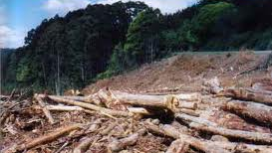
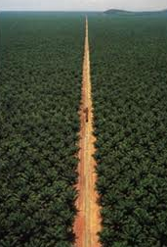
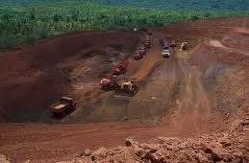
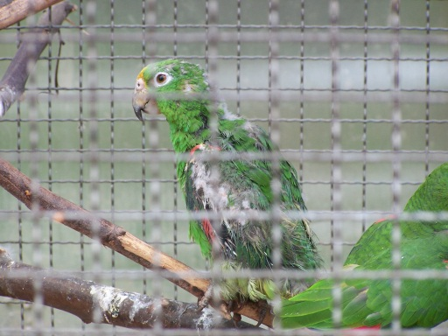
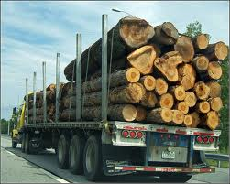
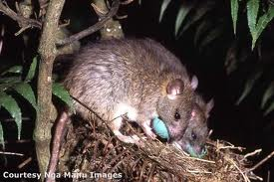
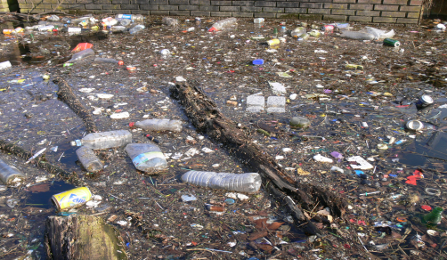
CAUSES OF TREATH
Habitat loss
Big infrastructure/agriculture development
Mining
Hunting (food, conflicts, illegal traffic)
Logging
Invasive species
Contamination

Slide 8
Thanks
Juan Ricardo Gómez S.
jrgomez@javeriana.edu.co

